Slide 1
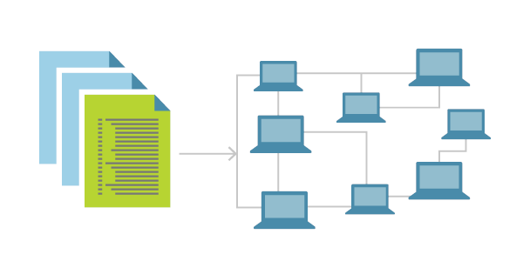
Introduction to Docker CI/CD

Slide 2
Continuous Integration
Orchestrating builds
Open source
Ecosystem
Jenkins

Slide 3
Commit changes to VC
Feedback
CI server
Jenkins
Build
Test
Deploy

Slide 4
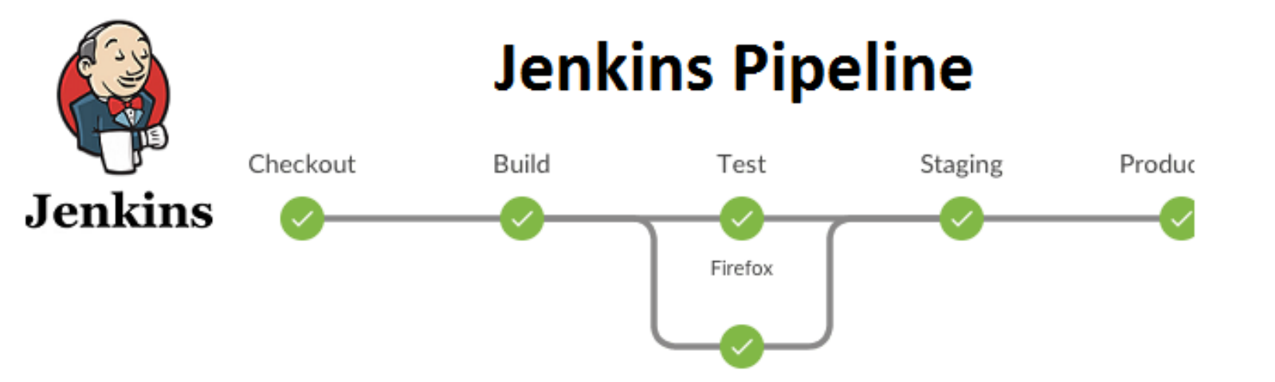

Slide 5
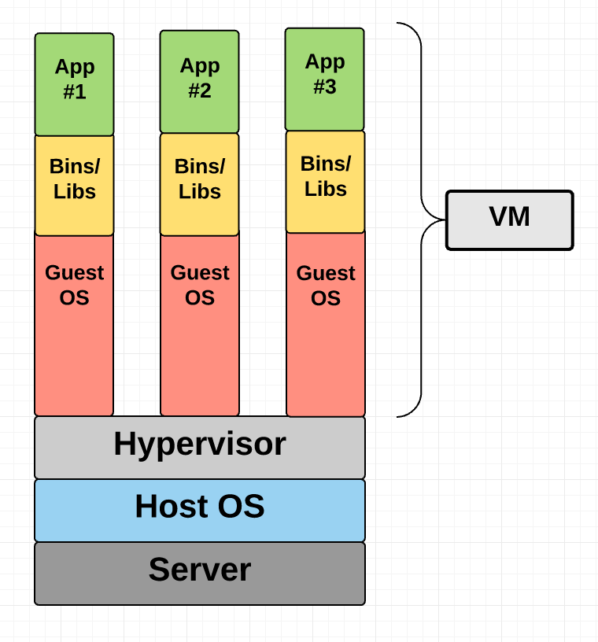

Slide 6
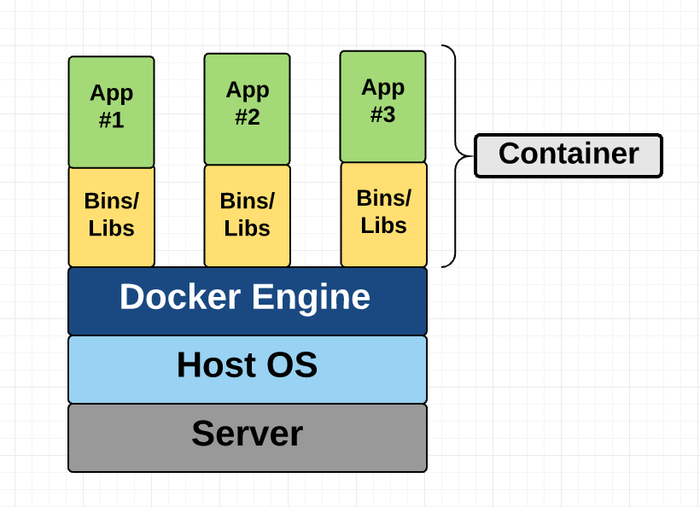

Slide 7
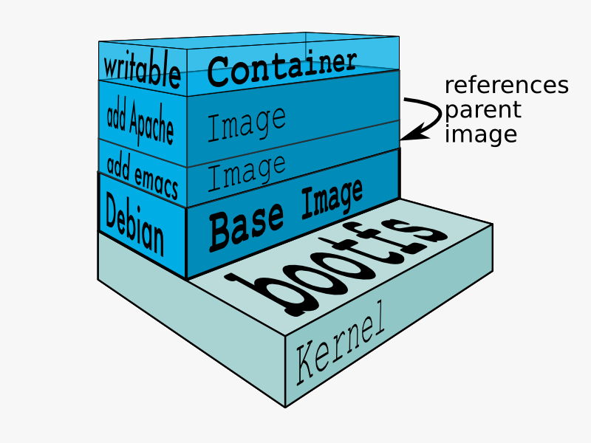

Slide 8
